Slide 1


Dorset Macmillan
Citizens Advice Service

Slide 2
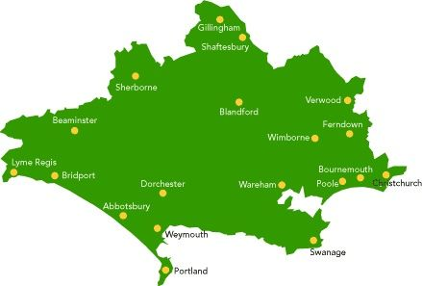

We are a team of 7 covering the whole of Dorset with the exception of Bournemouth, Christchurch & Poole - BCP

Slide 3
We accept referrals from:
Cancer Nurse Specialists
Cancer Support Workers
GP Surgeries
Social Prescribers
Weldmar Community Nurses
Hospices
Community Oncology
Other health professionals
Self referral
Family, Friends, colleagues
Macmillan Direct Services
Macmillan Health Professionals
Macmillan Website
Citizens Advice Offices
Other

Slide 4
We can help with questions like these and many more.
Some of the questions we are asked:
I am struggling to pay my bills as a result of my cancer diagnosis – what help can I get?
I have received a very complicated form about my benefits – can you help me with it?
My employer wants to sack me because I am sick – can they do that?
The cost of travel to my treatment and car parking is very high – where do I get help?
What benefits am I entitled to?

Slide 5
Providing specialist welfare benefits advice across Dorset to all people affected by cancer (patients, carers and family)
Maximising incomes, helping to complete applications, prepare reconsiderations and appeals, accessing charitable grants and signposting.
The service can offer advice and support via telephone, email and home visits.
Benefit advice services

Slide 6



Values and Principles
Free, independent, and impartial advice
Promoting self-help and independence
Collaborating with partners
Encouraging early intervention and preventative work
Providing timely, accurate quality advice and information
Valuing diversity, promoting equality, and challenging discrimination

Slide 7
Feedback from our clients:
Extremely supportive and helpful service. I would have not known that a number of services, financial, personal and emotional were on hand. thank you to all of you
My adviser was very helpful and understanding and she went out of her way to help me to grasp how better to look after myself with my disability. Thank you
Thank you so much for helping and supporting me in a period of uncertainty and overwhelm on my part
Without the help and knowledge from the fantastic staff at CA I know I would never have received the financial help from the DWP. Many thanks to everyone involved.
The service provided has been second to none. I can't believe the speed at which everything has been dealt with and the care and understanding shown. Thank you so much
Surprised to find such care & help was available, most impressed. Thank you

Slide 8



Contact us:
  01305 595971
  The phoneline is open 10am – 3pm, Monday to Friday
  An answerphone is operational outside of these hours
  macmillan.dorchester@centralca.org.uk
  Dorset Macmillan, Citizens Advice Central Dorset,
  1 Acland Road, Dorchester, Dorset DT1 1JW

