Slide 1

CAB Dorset presentation
28th November 2023
Michael Lloyd-Jones,
Senior Partnerships Manager, GWCU

Slide 2

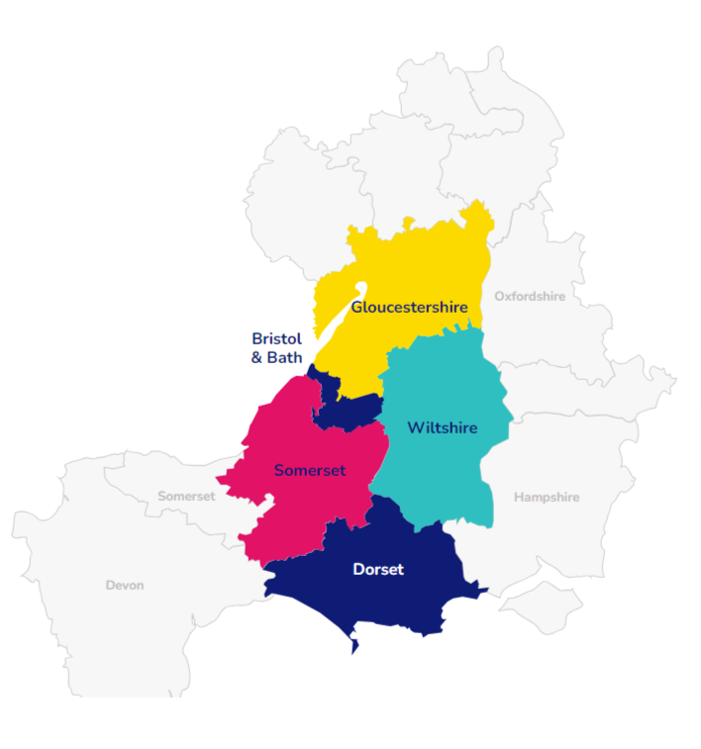

What is a credit union?
Not-for-profit, cooperative financial organisation.
  Providing affordable loans and accessible savings to their members, often financially vulnerable.
Limited operation in a "common bond" geography, employer, industry
Authorised and regulated financial services
  Authorised by the Prudential Regulation Authority
  Regulated by the Financial Conduct Authority and the Prudential Regulation Authority
  Accounts protected up to £85,000 by Financial Services Compensation Scheme

Slide 3
Who are GWCU?
Largest credit union in the region
  18,000 members
  £13.8m in assets
Not-for-profit, cooperative.
  Affordable loans, safe and accessible savings.
Authorised and regulated financial services
  Money is protected up to £85,000 through the Financial Services Compensation Scheme.
Committed to improving financial wellbeing.

Slide 4

What we offer
Affordable loans
Personal loan
  £100 to £15,000. APR from 13.9%
Advantage loan:
  £7,500 to £15,000. APR 7.9%
Family Finance Plan:
  Flexible via Child Benefit, £500 credit
Personal loan - Interest rates
From £100 to £1,749 - 42.6% APR
From £1,750 to £2,499 - 32.9% APR
From £2,500 to £4,999 - 22.9% APR
From £5,000 to £7,499 - 18.9% APR
From £7,500 to £15,000 - 13.9% APR

Slide 5



What we offer
Savings
Easy saver
  Simple online account, £1 minimum
Cash ISA
  3.5% AER tax free
Child saver & Christmas saver
  Flexible via Child Benefit, £500 credit

Slide 6


Money@Work
Simple savings and affordable loans through employee payroll

Slide 7
Social impact
Saving or borrowing with GWCU helps create a pool of money that recirculates in the regional economy.
Any profit is reinvested into our services or shared between our members as dividends
Members have a say in how we are run, through our AGM and our Members’ Forum

Slide 8
Get in touch:
Web: www.greatwesterncu.org
Email: info@gwcu.org.uk.

