Slide 1

East Dorset & Purbeck Citizens
Advice – Energy Unit
Citizens Advice have always offered energy advice,
However, for many years we have delivered more specialist energy advice
and training through various projects.
Who Am I:
Dan Fancy
Specialist Energy Adviser
Delivered Energy Advice and Energy Training for almost 2 years.
Worked on the following projects: Big Energy Saving Network; Energy Advice Programme; Fighting Fuel Poverty; Also on our most recent projects: Carbon Monoxide Advice Project, Energy Saving Trust.

Slide 2
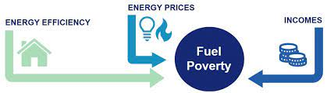
Fuel Poverty in England
Under the Low Income Low Energy Efficiency indicator, a household is considered to be fuel poor if:
  When the energy performance certificate (EPC) rating of their property is less than an EPC Band C
    AND
  The households net disposable income after modelled energy costs and housing costs is below the poverty line.
  In 2022, there were an estimated 13.4 per cent of households (3.26 million) in fuel poverty in England under the Low Income Low Energy Efficiency (LILEE) metric
  It is projected that by the end of 2023, fuel poverty will increase to 14.4 per cent (3.53 million)
https://www.gov.uk/government/collections/fuel-poverty-statistics#:~:text=Fuel%20poverty%20in%20England%20is,High%20Costs%20(%20LIHC%20)%20indicator.
https://assets.publishing.service.gov.uk/government/uploads/system/uploads/attachment_data/file/1139133/annual-fuel-poverty-statistics-lilee-report-2023-2022-data.pdf

Slide 3

Fuel Poverty – issues with definitions
The LILEE definition means that a household in a property with an energy efficiency rating of C or better (56% of dwellings in 2022) cannot be defined as being in fuel poverty, regardless of their income or the level of energy prices.
The definition in England is therefore better viewed as a measure of progress against the Government’s fuel poverty target
The NEA define a household as fuel poor if it needs to spend more than 10% of its income on energy to provide a satisfactory heating regime.
The Government has estimated that 8.8 million households (over 30% of households) in England could be classed as fuel poor in 2023 using the 10% definition.

Slide 4

Summary of recent energy developments
• Price cap now down to £1,923 for a typical bill, but Government energy support now ended (EBSS and EPG). So prices not particularly different to last winter
• Price cap increasing in January 2024. Typical annual bill £2,023 (based on the same ‘typical use’ as Oct 2021).
• More than one million households across the
Warm Home Discount and Energy Bill Support
Scheme missed out on £444m of support last
winter.
• Income support (CoL payments) continues for those in the social security system. But this is defrayed across different essentials.
• Energy debt has risen to £2.6 billion – its highest ever level.
• NEA polling has shown that about one third of
households believe they will struggle to heat their homes this winter.
• NEA have written to the UK Government to
question why they have not yet consulted on a
social tariff, with signatories from over 140
organisations and MPs
• Parliament recently debated energy social tariffs on 23/11, however still no mention of a consultation thus far.
• New YouGov Polling shows 1 in 4 UK adults have found it difficult to pay their energy bills in the last 3 months.
• 45 people die (in England & Wales) each day of the winter months due to cold homes.
• Standing charges are being reviewed by Ofgem.

Slide 5
Warm Home Discount 2023-2024
Opened on the 16th of October 2023.
Eligibility checking tool will also open on the same date: https://www.gov.uk/check-if-youre-eligible-for-warm-home-discount
You qualify if you either:
get the Guarantee Credit element of Pension Credit
are on a low income and have high energy costs
If eligible, will receive automatically. Keep an eye out for a letter being sent
Principal changes to eligibility criteria are:
Adjusting the high energy cost threshold: Lowering the threshold for a property considered as having high energy costs, so that more households will ultimately turn out to be eligible.
High-energy-cost carry over: The scenarios in which a household’s high-energy-cost status from a previous scheme year can be carried over into scheme year 13 and future scheme years, provided the high-energy-cost threshold is not raised.
https://assets.publishing.service.gov.uk/government/uploads/system/uploads/attachment_data/file/1183969/warm-home-discount-eligibility-statement-2023.pdf

Slide 6

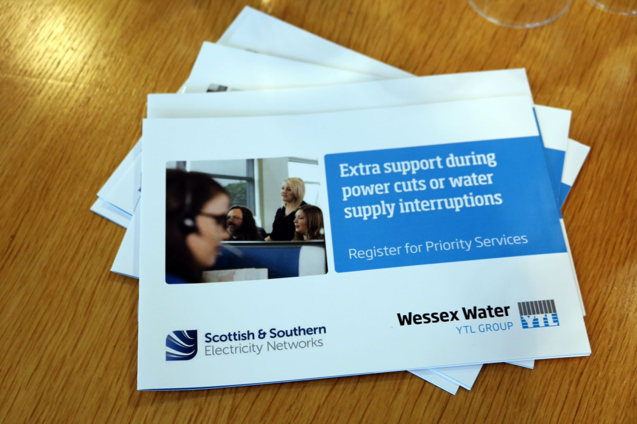
Priority Services Register
Offers extra services free of charge if someone is:
over 60
disabled or chronically sick
has a long-term medical condition
has a hearing or visual impairment or additional communication needs
in a vulnerable situation
Has children under 5
Online applications and leaflets cover both Water, Gas, Electricity and networks PSR
Links to websites are on the useful information list to be emailed after.

Slide 7
Priority Services Register- benefits
Advance notice of planned power cuts | If reliant medically on your energy supply network operators will give advance notice of planned power cuts, e.g due to engineering work.
Priority support in an emergency | The network operator can provide alternative heating and cooking facilities if supply interruption. The British Red Cross may be able to provide hot food, blankets and emergency batteries to vulnerable customers without power.
Identification scheme | Reassurance that callers, for example meter readers, are genuine Suppliers have to provide additional support to help identify someone acting on their behalf May include arranging a password or showing an agreed picture card upon visit.
Password protection | Network operators must offer to agree a password with you (or your representative) that can be used by any representative of the company to enable you to identify them.
Nominee scheme | Customers can ask their supplier to send communications to nominated family, carer or someone you trust.
Arrangements to ensure safe and practical use of your prepayment meter | For example if possible moving a prepayment meter if you are unable to access it safely to top it up.
Meter reading services at appropriate intervals. | If nobody living at your property is able to read the meter and there isn’t anyone else you can nominate to read the meter on your behalf, your supplier may be able to read it for you.
Accessible information | Account and bill information in an accessible format, e.g. larger print or braille.
Free gas safety checks, e.g. for a gas boiler, for eligible homeowners every 12 months | Eligibility criteria: means-tested benefit and live with a child under five live alone and are of pensionable age, disabled or chronically sick and live alone live with others who are of pensionable age, disabled, chronically sick or under 18 and you are also of pensionable age, disabled or chronically sick.

Slide 8


Energy Unit
Across Dorset & BCP Areas
The Energy Unit can assist households with:
  Eligibility for extra income
  Advice if struggling with energy bills and payments
  Resolving issues with energy suppliers
  Energy efficiency advice
  Accessing grants (SWG, HSF, AFG)
  Accessing WHD
  Registering on the PSR
Dorset & BCP Citizens Advice task on Casebook: “Energy Unit Dorset & BCP”
External agencies or clients: Email: energy@edpcitizensadvice.org.uk
🕿 01929 775500 Answerphone only

Slide 9

Free Energy Advice Training
We are also offering FREE Energy Advice Training to frontline workers.
There a 2 different types of training sessions available:
Full training – this is for those who are unfamiliar with energy issues, approx. 1 hour session
Refresher – this is for those who have previously received the training, or are already familiar with energy issues, and is a shorter 30-40 minute session
Please feel free to sign up for training using our Eventbrite. You can check for a training session that works within your schedule:
https://www.eventbrite.co.uk/o/east-dorset-and-purbeck-citizens-advice-38618096543
More sessions will be added for the new year

