Slide 1


Tuesday 28 November 2023
2 – 4pm
Via Zoom
Cost of Living Briefing

Slide 2
AGENDA
2pm | Welcome
2.05pm | Updates from: Citizens Advice Dorset Council - Benefits Dept for Work & Pensions Dorset Council – grants for VCSE organisations
2.55pm | BREAK
305 | Updates on: Energy issues - Energy Unit / Healthy Homes Support for older people – Age UK NSWD Great Western Credit Union Skills & Leaning: Multiply programme
4pm | CLOSE

Slide 3
About Citizens Advice: aims and principles
To give people the advice they need for the problems they face, and
To use our evidence to improve the policies and practices that affect people’s lives [our Research & Campaigns work]
  Advice is free confidential and independent, and is available to everyone
  We value and respect diversity, and promote equity
  We challenge discrimination and unfairness
  We work with colleagues and partners

Slide 4
On the frontline - current advice needs
Emergency help: food banks vouchers, PPM (prepayment meter) vouchers etc
Housing is emerging as a key issue: rising costs of rent and mortgages, notice, housing register, homelessness applications.
Energy advice: bills and payment methods (eg. Direct Debits), suppliers, grants, arrears, Warm Home Discount, Priority Service Register etc
Benefits: checks, changes, problems, deductions
Income maximisation: grants, Discretionary Housing Payments, budgeting, ways to save money, ‘passporting’
Debt management and options
Employment: insecure contracts, dismissal

Slide 5
Advice trends: what our national data tells us
National Citizens Advice monthly cost of living dashboards look at several key advice areas which are related to cost of living pressures:
Energy advice and energy debt
Charitable support and foodbanks
Homelessness
Personal Independence Payment claims
Council Tax arrears
The next slide shows the data from 2015 to October 2023 for the number of people coming to us unable to top up their PrePayment Meter (PPM)

Slide 6
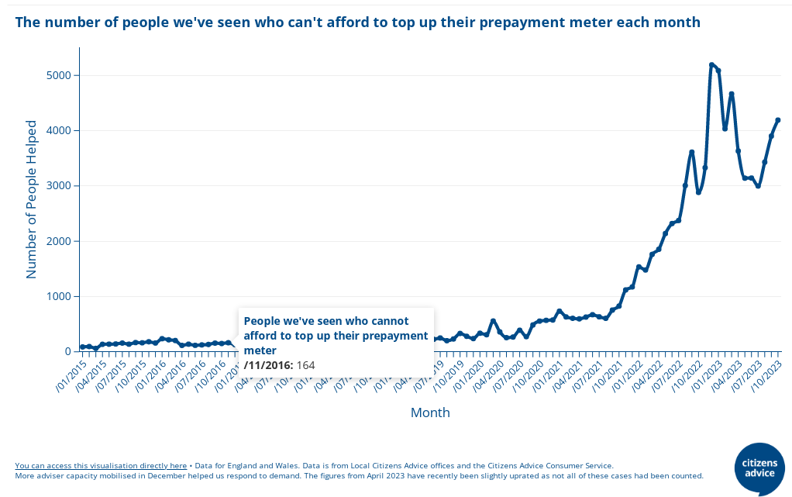

Slide 7
Advice trends: Local
For Citizens Advice in Dorset in Qtr 2 of 2023/4 (July - September) compared to previous quarter (April – June 2023):
A 19% rise in the overall number of clients helped.
A 13% increase in housing issues.
A 38% increase in issues raised for foodbank referrals and and other charitable help.
A 55% increase in benefit issues, a significant proportion being for help with Personal Independence Payment claims and appeals.
60% of clients told us they had a disability or long-term health issue.
Next slide: summary infographic

Slide 8
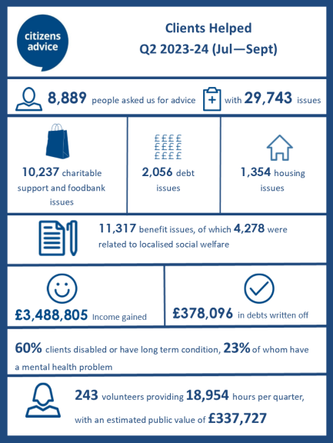

Slide 9
And how are cost of living worries affecting people?
More clients have a ‘negative budget’: despite paring back expenditure they cannot meet essential costs from their income.
Increasing numbers of people cannot afford essentials – food, heating, prescriptions, keeping up to date with their rent/mortgage …….
Those ‘regular’ clients who are on low incomes and/or have ‘chaotic lifestyles’ are coming more frequently, and use up short-term support (eg. max of 3 PPM vouchers in 6 months); sometimes people get angry.
Some people are coming to us for the first time, and have never had to ask about benefits or using a food bank.
More people are at risk of eviction, falling into debt or prey to loan sharks, physical and mental health deterioration, having to put up with poor employment options, and the knock-on stress impacting on families.

Slide 10
Government Support 2023/4 – the headlines
Cost of Living Payments for those on means-tested benefits: 3 payments totalling £900, the second paid in November.
One-off £150 or £300 Pensioner Cost of Living Payment – if entitled to Winter Fuel Payment; paid November.
£150 Disability Cost of Living Payment – paid during the summer.
Household Support Fund 4 + new Alternative Fuel Grant (funding via Dorset Council, delivered through Citizens Advice)

Slide 11
Government Support for energy costs
There is no Energy Bills Support Scheme this winter. The Energy Price Cap had reduced slightly, but…..
Ofgem has just announced:
From January 2024 the typical annual household bill will go up from £1,834 to £1,928, a rise of £94 or 5%. And:
For those on Prepayment Meters a typical annual bill will rise to £1,960
Those not paying by DD (eg. cash / cheque): £2,058
And these are only the ‘average’ bills…..

Slide 12
Our role in respect of Govt support
Explaining it to people: what it is, when they should get it, why they might not get it.
Helping people understand payments and chase late payments.
HSF grants (supermarket vouchers): helping with applications. Dorset HSF 4 opens one day a month.
Checking people had previous support, eg. cashed in PPM vouchers, chased a missed Cost of Living payment.

Slide 13
More on ‘Income Maximisation’ – what does it include?
Checking benefit entitlement, helping with claims and appeals, checking payments, challenging deductions
Making the most of passporting from means-tested benefits to other help, eg. free prescriptions, free school meals, Healthy Start Vouchers
Looking at childcare cost options
Social tariffs for water, phone/broadband
Energy efficiency advice
Money saving tips
Helping prepare a budget, helping people understand how to prioritise payments etc
Accessing grants and discretionary payments (eg. DHP)
Ensuring people get the Govt support they are entitled to

Slide 14
Looking ahead?
Without the Energy Bills Support Scheme we expect people to struggle with utility bills again this winter.
Short –term support is welcome BUT we need some longer-term policy changes, for example:
an energy social tariff
a reduction in gas and electric standing charges
a detailed review of benefit rates
a speeding up of the process for dealing with PIP applications…...

Slide 15

What else are we doing to help and support people?
Working in partnership with the many other organisations across Dorset and BCP supporting people.
Co-locating services in community venues people are using eg. foodbanks
Using our evidence to bring about change: we’ve contributed to making the case that benefits should be uprated by 6.7% and the need for the Local Housing Allowance rates to be reviewed.
Disseminating clear and up-to-date information (contact me if you want to sign up to the fortnightly E News!).
Caroline.buxton@centralca.org.uk

Slide 16

Any questions?
Please put any questions or comments in the Chat and even if we cannot respond during the session we can circulate further information and responses.

Slide 17
Bridport Citizens Advice – specialist benefits service
This provides specialist advice on complex benefit cases, including benefit challenges and appeals, and is accepting referrals from Dorset partnership agencies. Three benefit advisers provide second-tier benefit advice on:
benefit rights and entitlements
disputes, appeals,
overpayment recovery issues and alleged benefit fraud.
The team at Bridport will advise on the merits of a case, gather testimony from clients, prepare written evidence and represent in person at benefit tribunals, for example for people who have been turned down for Personal Independence Payment (or had it reduced following a review), or who have “failed” a work capability assessment.
Contact: by email: advice@bridport-cab.org.uk or by using the “contact” form on their website: Bridport and District Citizens Advice | Contact Us (bridportca.org.uk) (please state “Henry Smith referral” in the subject line)

